Slide 1

Artificial Intelligence-B1 Slot
Presented by Ishani Anurag-24BRS1317
Black-Box Detection
of Prompt Injection & Jailbreak Attacks in LLMs

Slide 2
Black-Box Detection
Agenda
This presentation is organized around the following three themes:
01
02
03
Background & Motivation
Domain context, threat landscape, literature survey, and research gaps
Methodology & Architecture
Problem statement, proposed architecture, and black-box detection method
Results & Outcomes
Experimental setup, feasibility analysis, and expected outcomes

Slide 3

Black-Box LLM Security
Domain & Motivation
Large Language Models (LLMs) are rapidly being integrated into production applications, expanding the attack surface for adversarial inputs. Prompt injection and jailbreak attacks exploit model behavior to bypass safety guardrails, leak sensitive data, or manipulate outputs. As adoption scales across industries, the absence of robust, black-box detection mechanisms poses critical security risks that demand immediate research attention.

Slide 4
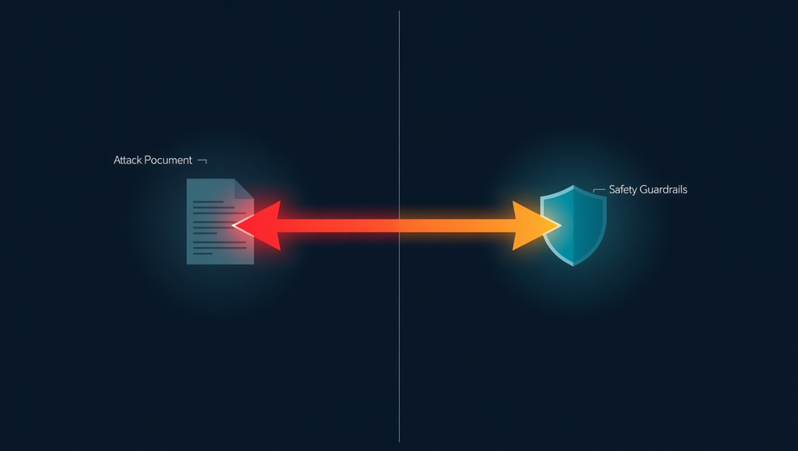
Black-Box LLM Security
Prompt Injection vs Jailbreak
Attack Vector:
Prompt Injection (external) / Jailbreak (user-crafted)
Prompt Injection embeds malicious instructions within external input to hijack LLM behavior, redirecting the model away from its intended task. Jailbreak attacks craft adversarial prompts to bypass safety guardrails and elicit restricted outputs. While both exploit the model's instruction-following nature, they differ in origin, target, and mechanism — making detection a dual challenge.
Mechanism:
Instruction Hijacking / Safety Guardrail Bypass
Detection Challenge:
Context-Dependent / Semantically Obfuscated

Slide 5

Black-Box Detection
Prompt Injection & Jailbreak
Literature Survey
01
Key studies on adversarial attacks targeting LLMs (Perez & Ribeiro, 2022; Greshake et al., 2023)
02
Detection approaches: output monitoring, semantic similarity, and classifier-based methods
03
Benchmark datasets: AdvBench, JailbreakBench, and TrustLLM evaluation suites
04
Evaluation metrics: attack success rate (ASR), false positive rate, and detection F1-score

Slide 6
Ingoude Company
Research Gaps
Most existing detection methods rely on white-box access to model internals (weights, logits, or activations), leaving black-box deployment scenarios largely unexplored and underprotected.
Current benchmarks lack diversity in adversarial prompt types and fail to evaluate cross-domain generalization, resulting in detection systems that are brittle against novel or adaptive injection strategies.

Slide 7

Black-Box LLM Security
Problem Statement
The core challenge is developing a reliable detection system for prompt injection and jailbreak attacks without internal model access. Key problem dimensions include: (1) detecting malicious inputs in real-time under strict latency constraints, (2) classifying attacks purely from observable input-output behavior, and (3) generalizing across diverse LLM deployments where internal weights and architectures remain inaccessible. Existing solutions rely on white-box access, leaving black-box API-based deployments critically unprotected.

Slide 8

Black-Box LLM Security
Proposed Architecture
The proposed architecture operates as a black-box wrapper around any LLM application. It intercepts user inputs and model outputs, applying a multi-stage pipeline of preprocessing, feature extraction, and classification to detect prompt injection and jailbreak attempts in real time without modifying the underlying model.
Pipeline components:
Input processing & normalization layer
Feature extraction & embedding module
Classification & threat scoring engine

Slide 9

Black-Box LLM Security
Presented by Research Team
Proposed Detection Method
Our black-box detection pipeline employs three core techniques:
01
Behavioral Analysis: Monitor output deviations and response pattern shifts across queries
02
Pattern Recognition: Classify adversarial input signatures using n-gram and semantic embeddings
03
Anomaly Scoring: Assign risk scores via statistical divergence from benign baseline distributions
These techniques operate without internal model access, enabling scalable real-world deployment.

Slide 10
Black-Box Detection
Experimental Setup
Experimental
Setup
Datasets: Ajentdojo,AdvBench, JailbreakBench, and custom prompt injection corpora. Baseline models: GPT-3.5-Turbo, LLaMA-2, Mistral-7B.
Evaluation metrics: Accuracy, F1-Score, False Positive Rate, and AUC-ROC. Testing configurations include zero-shot, few-shot, and adversarial transfer scenarios across multiple LLM APIs.

Slide 11


Black-Box LLM Security
Prompt Injection & Jailbreak Detection
Feasibility Analysis
Key feasibility dimensions assessed:
01
Computational overhead is minimal — black-box probing requires only API-level queries with no model access
02
Scalable across diverse LLM deployments; detection logic is model-agnostic and infrastructure-independent
03
Key challenges include query rate limits, response latency, and adversarial evasion of detection probes
Overall feasibility is high — the approach is lightweight, deployable, and adaptable to real-world LLM systems.

Slide 12

Black-Box LLM Security
Presented by Helene Paquet
Expected Outcomes
Anticipated results of this research:
01
High detection accuracy (>90%) for prompt injection and jailbreak attacks
02
Deployable black-box defense with minimal latency overhead in LLM APIs
03
Open benchmarks and future directions for adversarial robustness research
These outcomes aim to advance secure, trustworthy deployment of LLM-based applications.

